Slide 1
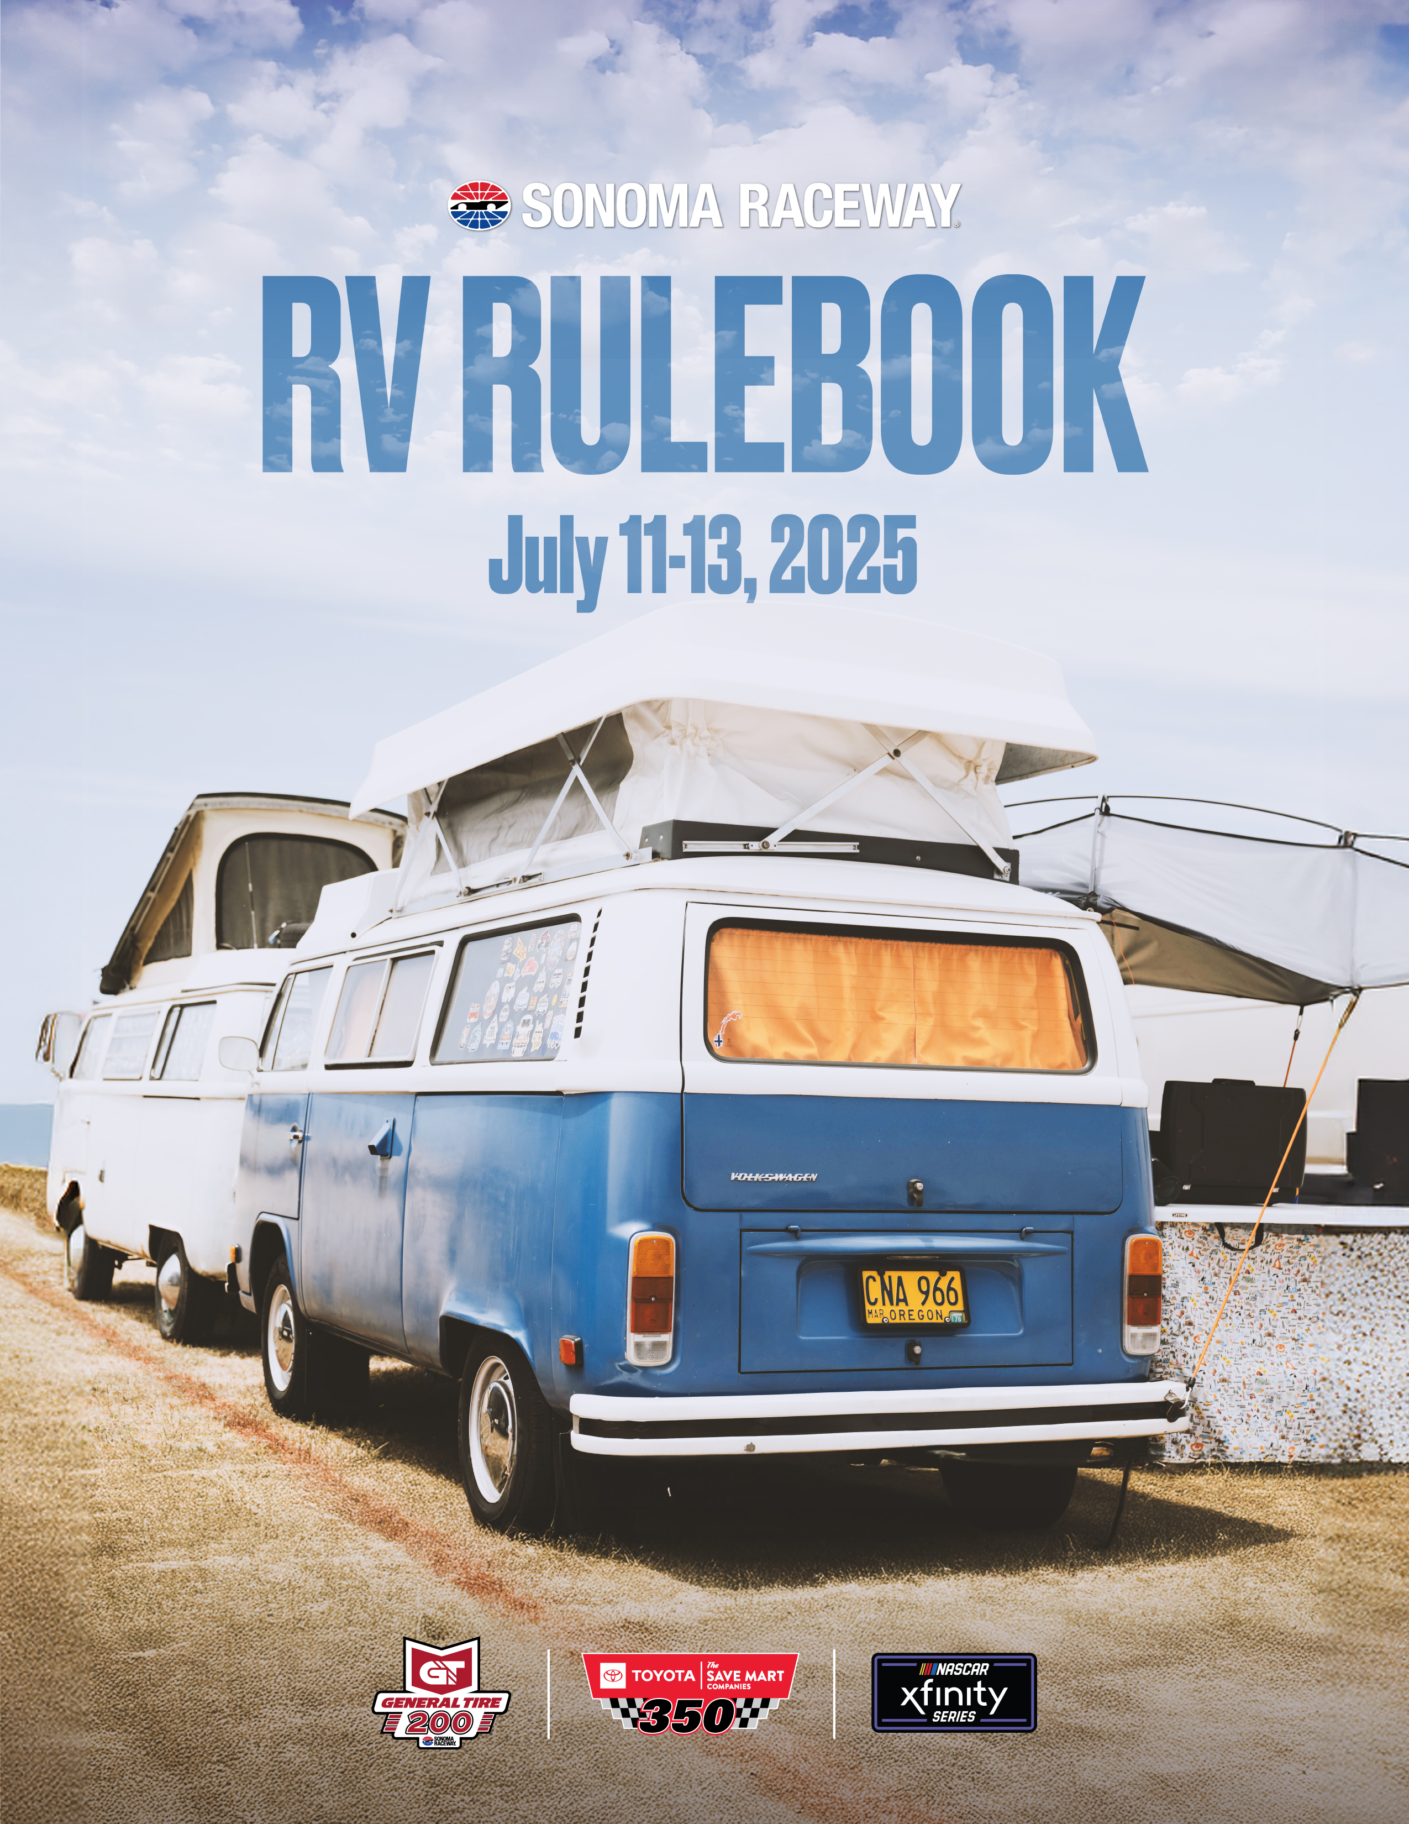

Slide 2

Welcome to NASCAR Weekend
at Sonoma Raceway!
We are glad you are here and hope you enjoy the schedule of events planned during your visit. Please read the enclosed information very carefully to make your visit to Sonoma Raceway enjoyable and safe. The following rules will be strictly enforced by raceway security and the Sonoma County Sheriff’s Department.
Sonoma Raceway owns and controls all rights to space locations for all events at the track. RV parking passes are temporary licenses for the space beginning July 10 at 10 AM to July 14 at Noon. The camping permit licenses the holder to park one (1) RV or truck/trailer plus one (1) vehicle in the assigned area for the event specified. All vehicles must fit within the 20' x 40' space and not block any fire lanes. All vehicles that do not fit within the space must be moved to overflow parking areas. Commercial activities of any kind are prohibited without prior written consent from Speedway Motorsports or Sonoma Raceway.
Park at your own risk - Speedway Motorsports/Sonoma Raceway and their officers, agents, employees and affiliates are not liable for loss of any kind to the vehicle or other property of the permit holder. Acceptance of this permit constitutes acknowledgment by holder that he/she has read and consents to the terms herein.
Any damage incurred to Sonoma Raceway property by individual RVs/Campers will be the responsibility of the ticket/account holders who may be billed for such damages.
Sonoma Raceway will make every effort to ensure your campsite location is in the same space year after year. But, due to constant improvements throughout the property, there is no guarantee that your space will remain the same.

Slide 3
ARRIVAL INFORMATION
Sonoma Raceway Campgrounds open at 10 a.m. on July 10. When you arrive at the raceway, everyone in the vehicle must have event weekend tickets to enter. Check-in times are as follows:
  Thursday, July 10: 10 AM to 10 PM
  Friday, July 11: 8 AM to 10 PM
  Saturday, July 12: 8 AM to 10 PM
For premium campgrounds (The Point, RV Terraces, Carousel, Turn 7, Turns 3/4, Turn 1, Cougar Mountain, Turn 8, The Chute), enter Gate 1.
CHECK-IN INFORMATION
The 50 Acres Campground is not open for camping check-in 24 hours a day. You must arrive during the times listed above. If you arrive after 10 p.m., you will be asked to stage in the Gate 7 driveway until the following morning when the campgrounds reopen. For premium campgrounds (The Point, RV Terraces, Carousel, Turn 7, Turns 3/4, Turn 1, Cougar Mountain, Turn 8, The Chute), enter Gate 1.
ENTRY & PRE-SCREENING
During the camping check-in process, guests will be asked to stay in their vehicle for pre-screening. The pre-screening process includes a brief security search of your RV. Security will be looking for items that are not allowed in the campgrounds including, but not limited to, weapons, potato guns, fireworks and off-highway vehicles.

Slide 4
ARRIVAL INFORMATION (continued)
TICKETS
Event weekend tickets are required to enter all campgrounds including the 50 Acres Campground.
CAMPING PASSES
Sonoma Raceway will issue digital camping passes which are accessible through Sonoma Raceway’s Mobile App, or alternatively from a Ticketmaster or Account Manager Account. Each camping pass allows one (1) RV or truck/trailer plus one (1) vehicle in the assigned area for the event specified. All vehicles must fit within the 20' x 40' space and not block any fire lanes. All vehicles that do not fit within the space must be moved to overflow parking areas.
ADDITIONAL VEHICLES
There are a limited number of additional vehicle parking spaces in all campgrounds. You are not guaranteed an additional vehicle parking space. If you cannot fit your tow vehicle or passenger car in your camping space and all designated spaces are full, additional vehicle parking for trackside campers is located in Lot 4. For the 50 Acres Campground, additional vehicles may be parked in the open lot between tent camping and Row H.

Slide 5


CAMPGROUND RULES & REGULATIONS
GOLF CARTS / OFF-HIGHWAY VEHICLES
For the safety of all guests, golf carts, hover boards, quads, UTVs, side-by-sides, scooters, skateboards, Segways, dirt bikes, motorized furniture, or any other similar personal transportation devices are strictly prohibited on Sonoma Raceway property.
  Pedal-assist e-bikes are allowed in camping areas only (e-bikes must have pedal-assist capabilities, not pegs or foot rests). They may not be ridden to access seating areas or the Fan Zone. Pedal-assist e-bikes will not be allowed to cross Highway 121 from the 50 Acres Campground to the road course.
  Street legal, licensed motorcycles with off-road or dual-sport tires are not allowed on raceway property. Only licensed motorcycles with street-only tires are allowed.
If any of these vehicles are brought to the raceway, you will be asked to impound the vehicle prior to parking in your camping space. Impound is located through Gate 6 in the 50 Acres Campground. If guests refuse to impound their vehicle, they will be turned away and not allowed to enter the facility. Single-person electronic convenience vehicles, built specifically for guests with disabilities, are permitted.
Impounded vehicles can be picked up Sunday after the race and on Monday morning. Exact pick-up times will be provided when you arrive at the campground. When picking up your impounded vehicle, you must arrive in your RV prepared to leave the campground. You will not be allowed to return to your camping space.
Off-road motorcycles with valid license plates will be impounded for the weekend. These are motorcycles that are clearly built for off-road activities with off-road, knobby tires. Only licensed motorcycles built to drive on the street, with street-only tires, can enter the raceway. If you have questions on whether your motorcycle can enter, please contact Maurice McGill at mmcgill@sonomaraceway.com.

Slide 6
CAMPGROUND RULES & REGULATIONS (continued)
ADDITIONAL CAMPGROUND POLICIES
The following activities are not allowed on the raceway property:
Charcoal barbecues are not allowed at Sonoma Raceway. Gas grills using propane are permitted.
Open-flame or open-pit campfires are prohibited.
Camping is permitted in designated areas only.
Keep fire lanes open at all times. Cars will be towed away if parked in fire lanes.
Offensive signs, public drunkenness, and profanity will not be tolerated.
The selling of unauthorized merchandise is prohibited.
Alcohol is allowed in camping areas. However, alcohol may not be brought from campgrounds to seating or pit areas.
Alcohol may not be sold or distributed to people other than those staying in your RV or camping area.
No waste-water dumping is allowed. Those caught dumping are subject to fine, arrest, or immediate ejection from the raceway.

Slide 7
CAMPGROUND RULES & REGULATIONS (continued)
No fireworks
No weapons of any kind
No commerce
No Confederate flags or other offensive signs/flags may be displayed.
All radio-controlled aerial devices including, but not limited to, sky lanterns, drones and any unmanned aerial devices are not allowed on Sonoma Raceway property.
You cannot plug in electrical cords to raceway generators or light towers.
All vehicles and RV sites are subject to search.
At no time is it ok to ride a bicycle or walk on the race track. If anyone is caught on the race track they will be arrested and removed from the raceway property.
PROHIBITED ACTIVITIES
The following activities are not allowed on Sonoma Raceway property:
    Solicitation for donations
    Unauthorized selling or buying of event tickets
    Unapproved selling of merchandise or services
    Unapproved distribution of any item
    Unapproved entertaining (organized concerts and events not approved by
    the raceway are prohibited)
QUIET HOURS
Quiet hours are from 11 PM to 8 AM Music and generators above a certain decibel (see Generator information) as well as other loud devices must be turned off during quiet hours. If Sonoma Raceway security is called to your space due to a disturbance, the RV owner will be given a written warning. Multiple warnings will result in forfeiture of RV passes and removal from the campground.
Please be responsible during quiet hours
and be respectful to your neighbors.

Slide 8
CAMPGROUND RULES & REGULATIONS (continued)
GENERATORS
Running a generator in your campsite can create undesirable noise and produce harmful carbon monoxide fumes. To help prevent disruption in our camping areas, please note the following rules for generator use:
All generators must have the exhaust directed up and above the top of your trailer, truck, RV or tent/awning and clear of your neighbor’s campsite. Generator exhaust systems can be purchased at camping/RV stores or online. Do-it-yourself options are also available online.
Generators should be turned off from 11 PM to 8 AM (quiet hours). If a medical condition requires you to leave your generator running all night, your generator must operate at less than 70 decibels at all times. If you have a medical condition and your generator is louder than 70 decibels as determined by security staff, you will be asked to relocate to a different area in the campground.
PETS & SERVICE ANIMALS
Pets are allowed in camping areas only. Trained service animals are allowed in competitor pit and seating areas. Service animals must remain on a leash (no more than 6’ in length) or harness at all times. You must pick up after your pet.
SPEED LIMITS
The speed limit in RV areas is 5 mph.

Slide 9
GENERAL INFORMATION
ADA ASSISTANCE / SHUTTLE SERVICE
Sonoma Raceway offers a free shuttle service to move guests around the property. Shuttle stops are conveniently located near all seating areas, parking lots and campgrounds. In addition to shuttles, the raceway offers a golf cart service for guests with mobility issues.
  50 Acres Campground:
    Golf carts will be in the 50 Acres Campground to pick up guests to take them to the bag check area at Gate 3. Once guests are through the bag check, golf carts will be available to help people cross Highway 121 and drop them at stops near the grandstand and terrace seats.
IMPORTANT PHONE NUMBERS
  Medical Emergencies: call 9-1-1
  Security: (707) 933-4455
  General Information: Please call (800) 870-RACE [7223]
PEDESTRIAN SAFETY
While walking, jogging or moving around the property, we ask that you use caution, particularly after hours, to prevent injury.
  Remain alert for service traffic and shuttles.
  After dark, use a flashlight as portable light towers may not illuminate all areas.
  Do not cut through other guests’ spaces as this is inconsiderate and will take you off the designated roadway/walking areas.
  Obey all signs around the property.

Slide 10
GENERAL INFORMATION (continued)
RV SERVICES
Sonoma Raceway has teamed up with United Site Services to provide RV pump-and-dumps and fresh water filling. Contact phone numbers will be available during RV check-in.
SHOWERS
Shower facilities will be open and portable restrooms will be available in all campgrounds. Shower facilities are located in 50 Acres and in RV Terrace Row A.
EVENT POLICIES
BAGS & BACKPACKS
A maximum of two (2) bags per person are permitted through the ticket gates. Clear bags are recommended but not required. Fans are permitted to bring items in non-clear bags such as backpacks and tote bags as long as those bags are no larger than 18x18x14 inches.
COOLERS
Soft-sided coolers that do not exceed 14x14x14 inches are permitted.

Slide 11
EVENT POLICIES (continued)
PROHIBITED ITEMS
Existing Raceway Policies will continue to be enforced. The following items are NOT allowed at the raceway:
  Aerosol cans (with the exception of sunscreen, sun block, hand sanitizer, and bug spray)
  Alcoholic beverages
  Bottles/glass containers
  Cans
  Displays of the confederate flag
  Drones
  Dry ice
  Foam or hard-sided coolers regardless of size
  Fireworks/sky lanterns
  Frisbees, balloons or any other projectile
  Inline skates/skateboards/bicycles/hover boards
  Laser pointers, noise makers and air horns
  Lawn chairs and stadium-style seats with legs (all cushions must sit flat against your seat)
  Selfie sticks
  Tripods or monopods that are either solid or collapsible
  Umbrellas in seating areas
  Wagons
  Weapons, including but not limited to: guns, knives, stun guns, and pepper spray
Note: Any items which pose a safety hazard or can diminish the
enjoyment of the event by other guests are prohibited.
All items and persons are subject to search and seizure. You can choose to take prohibited items back to your car or campground or surrender them to security. Once an item is surrendered it cannot be reclaimed.

